Slide 1
STARSHIP-IMPROVED

Slide 2
Team InTro
LAURA
DAVID
DIDI
EMEKE

Slide 3
Game Description
Starship is a single-player ASCII adventure game. Players can traverse space while avoiding alien attacks, asteroids, and picking up supplies from various spatial bodies to colonize Mars.

Slide 4
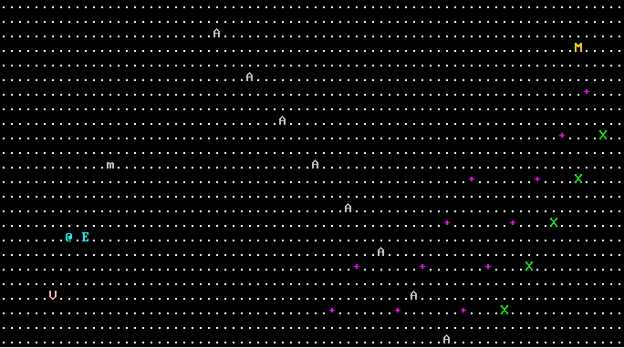
BEFORE
Notes:
Narrative of the game before….

Slide 5
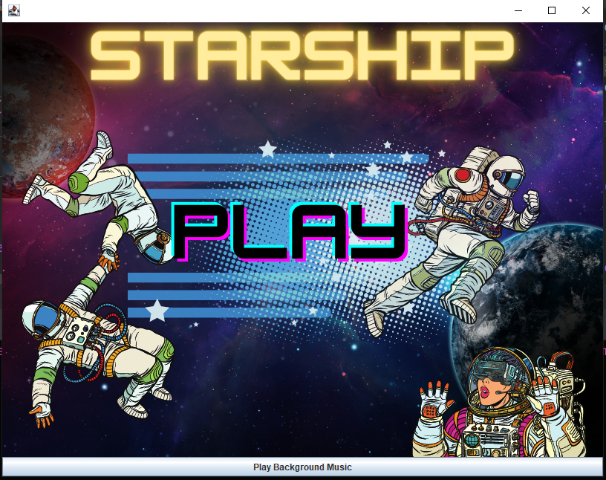
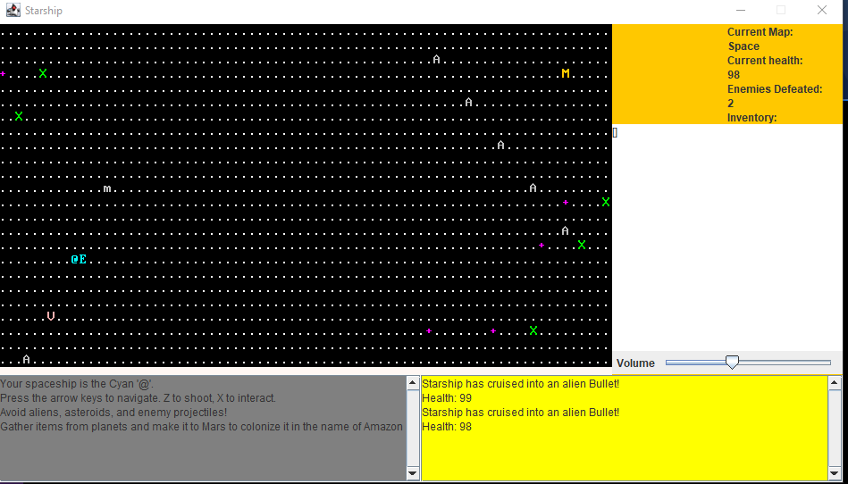
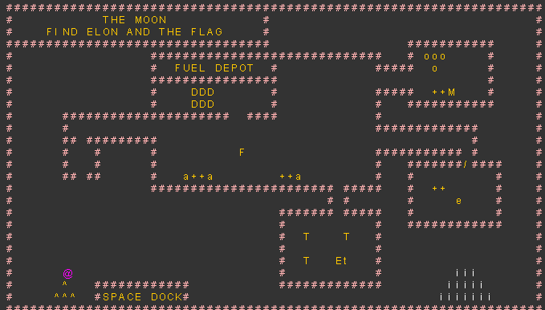
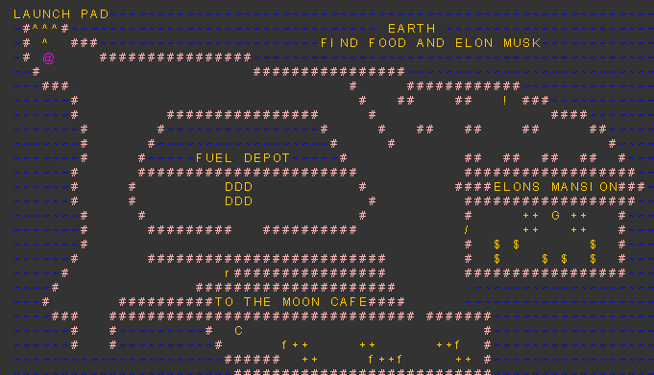
AFTER
Notes:
Narrative intro of the game, objectives and features.

Slide 6
Starship Improved
GUI
Audio
Sound Effects/Audio Control
ASCII Maps
Menu Page
HUD
BGM

Slide 7
Feature Highlights
Intro Panel
Collision Visual/Sound Effects
HUD and Output panels
Planet Ascii maps
Player facing and interactions
Volume Controls
Background Music

Slide 8
Learning Challenges
Inherited Code
Minimal Separation of Concerns
Dense Classes
Unit Testing
Swing/JFrame (GUI)
Audio Control

Slide 9
Test Run

Slide 10
Feature Wishlist
Additional Planets
Additional Soundtrack
More Sound Effects
Save Features
Multiplayer
Difficulty Levels

Slide 11
Credits
Special thanks to all the people who made and released all versions of Starship!

Slide 12
Questions?

Slide 13
Thanks!

